Slide 1


CSS 3
Web Design Revolution
Notes:
© SUPINFO International University - http://www.supinfo.com
SUPINFO vous permet de partager ce document
Vous êtes libre de :
Partager — reproduire, distribuer et communiquer ce document Remixer — modifier ce document
A condition de respecter les règles suivantes :
Indication obligatoire de la paternité — Vous devez obligatoirement préciser l’origine « SUPINFO » du document au début de celui-ci de la même manière qu’indiqué par SUPINFO International University – Notamment en laissant obligatoirement la première et la dernière page du document, mais pas d'une manière qui suggérerait que SUPINFO International University vous soutiennent ou approuvent votre utilisation du document, surtout si vous le modifiez. Dans ce dernier cas, il vous faudra obligatoirement supprimer le texte « SUPINFO Official Document » en tête de page et préciser notamment la page indiquant votre identité et les modifications principales apportées.
En dehors de ces dispositions, aucune autre modification de la première et de la dernière page du document n’est autorisée.
NOTE IMPORTANTE : Ce document est mis à disposition selon le contrat CC-BY-NC-SA Creative Commons disponible en ligne http://creativecommons.org/licenses ou par courrier postal à Creative Commons, 171 Second Street, Suite 300, San Francisco, California 94105, USA modifié en ce sens que la première et la dernière page du document ne peuvent être supprimées en cas de reproduction, distribution, communication ou modification. Vous pouvez donc reproduire, remixer, arranger et adapter ce document à des fins non commerciales tant que vous respectez les règles de paternité et que les nouveaux documents sont protégés selon des termes identiques. Les autorisations au-delà du champ de cette licence peuvent être obtenues à support@supinfo.com.
© SUPINFO International University – EDUCINVEST - Rue Ducale, 29 - 1000 Brussels Belgium . www.supinfo.com

Slide 2

Course objectives
CSS 3
By following this course, you will be able to:
Enumerate CSS3 attributes
Use level 3 selectors
Do media queries
Explain namespaces concept
Use LESS Framework

Slide 3


Course plan
CSS 3
Attributes
Selectors level 3
Media queries
Namespaces
LESS framework

Slide 4
New Attributes
CSS3

Slide 5


Presentation
Attributes
CSS3 is part of HTML5 specification
Composed of several specifications
Developped by W3C and WHATWG
At the moment, partially implemented by browsers
Notes:
http://www.w3.org/Style/CSS/current-work

Slide 6

Presentation
Attributes
Since CSS3, new attributes are usable
Can be sorted in four categories
Containers
Backgrounds
Texts
Transforms
We’ll discover them now!

Slide 7

Browser Compatibility
Attributes
Be careful: CSS3 support is still in progress!
Depending on your browser, you may have to prefix attributes by the vendor specific code:
Browser | Property scheme
Internet Explorer | -ms-propertyName
Opera | -o-propertyName
Konqueror | -khtml-propertyName
Gecko based | -moz-propertyName
Webkit based | -webkit-propertyName
Notes:
http://www.w3.org/TR/CSS21/syndata.html#vendor-keywords
http://peter.sh/experiments/vendor-prefixed-css-property-overview/

Slide 8


Containers
Attributes
Box-Shadow:
Set a shadow on blocks
border-radius: left top size color;
div { box-shadow: 4px 4px 2px #AAA; }

Slide 9

Containers
Attributes
Box-sizing:
Allow to override default width and height calculation
box-sizing: type-box;
Where type-box can be:
border-box
padding-box
content-box

Slide 10
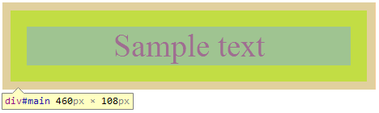
Containers
Attributes
Box-sizing:
Example with content-box:
div {
box-sizing: content-box; padding: 20px;
border:10px solid #AAA; width: 400px;
/* Actual width is 460px (400 + 20*2 + 10*2) */
}

Slide 11
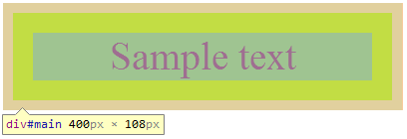
Containers
Attributes
Box-sizing:
Example with border-box:
div {
box-sizing: border-box;
padding: 20px;
border:10px solid #AAA;
width: 400px;
/* Actual width is now
400px */
}

Slide 12

Containers
Attributes
Border-Radius:
Round corners
border-radius: top-left top-right bottom-right bottom-left;
div { border-radius: 10px 5px 20px 0; }
Notes:
Online generator : http://border-radius.com/

Slide 13

Containers
Attributes
Border-Image:
Renders a border based on a specific image
Outputs image over background definitions
border-image: url size x-mode y-mode;
div { border-image: url('css3.png') 20% repeat repeat; }
Notes:
http://www.w3.org/TR/css3-background/#layering

Slide 14
Backgrounds
Attributes
Background-Origin:
Change the default origin for background images
Margins (no box)
Border box
Padding box
Sample text
Content box
Notes:
Given : div { background-image: url('css3.png'); border: 10px solid #AAA; padding: 20px; }

Slide 15


Backgrounds
Attributes
Background-Origin:
Change the default origin for background images
div {
background-origin:
border-box;
}
div {
background-origin:
padding-box;
}
Notes:
Given : div { background-image: url('css3.png'); border: 10px solid #AAA; padding: 20px; }

Slide 16
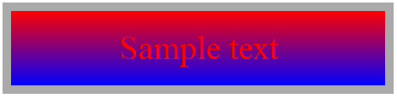
Backgrounds
Attributes
Linear-Gradient:
Advanced gradient tool
background: linear-gradient(color1, color2 [,colorN])
div { background: linear-gradient(red, blue) }
Notes:
More info on http://www.webkit.org/blog/1424/css3-gradients/

Slide 17

Backgrounds
Attributes
Radial-Gradient:
Advanced gradient tool
background: radial-gradient(circle, color1, color2);
div { background: radial-gradient(circle, red, blue) }
Notes:
More info on http://www.webkit.org/blog/1424/css3-gradients/

Slide 18
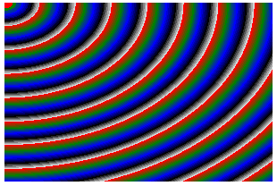
Backgrounds
Attributes
Radial-Gradient can take many parameters in order to perform complex gradients
Complex example:
div {
background:
repeating-radial-gradient(
0 0, ellipse farthest-corner, red 0px,green 10px, blue 20px, black 30px, white 40px
)
}
Notes:
https://developer.mozilla.org/en-US/docs/CSS/Using_CSS_gradients?redirectlocale=en-US&redirectslug=Using_gradients
https://developer.mozilla.org/en-US/docs/CSS/repeating-radial-gradient?redirectlocale=en-US&redirectslug=CSS%2F-moz-repeating-radial-gradient

Slide 19
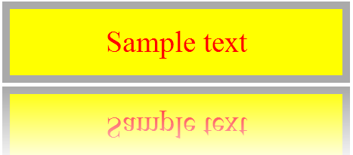
Backgrounds
Attributes
Box-Reflect:
Show a reflection effect on the target
box-reflect: direction margin mask-box;
div { box-reflect: below 5px
linear-gradient(transparent, white); }
Notes:
Other example on : http://stuntsnippets.com/css3-reflection/

Slide 20

Texts
Attributes
Text-Shadow:
Set a shadow on texts
text-shadow: right top size color;
span { text-shadow: 4px 4px 2px #AAA; }

Slide 21

Texts
Attributes
Text-Stroke:
Define a color wrap around texts
text-stroke: size color;
span { text-stroke: 2px black; }

Slide 22
Texts
Attributes
Now you can set columns to blocks!
Use these three properties:
Column-count:
Splits entire text by specified number
Column-gap
Sets margins between each column
Column-width
Specifies each column width

Slide 23
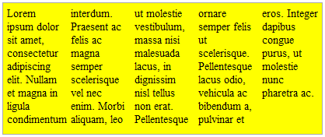
Texts
Attributes
Columns example:
column-count: number;
column-gap: gap;
column-width: width;
Usage:
div {
column-count: 5;
column-gap: 10px;
column-width: 40px;
}
Notes:
On utilise que deux des attributs combinés plutôt que les trois parce que là c’est trop fixé

Slide 24
Transforms
Attributes
Many transformations handled by the transform attribute
Scale
Rotate
Translate
We’ll see all the left ones
Matrix
Perspective
Skew

Slide 25

Transforms
Attributes
ScaleX/Y/Z:
Increase or reduce the element’s dimensions
scaleX(number); scaleY(number); scaleZ(number);
div { transform: scaleX(2); }

Slide 26

Transforms
Attributes
RotateX/Y/Z:
Perform a rotation
rotateX(Ndeg); rotateY(Ndeg); rotateZ(Ndeg);
div { transform: rotateZ(10deg); }

Slide 27

Transforms
Attributes
TranslateX/Y/Z:
Push the element in the specified direction
translateX(Ndeg); translateY(Ndeg); translateZ(Ndeg);
div { transform: translateX(-50px); }
Notes:
In the HTML namespace, the transform property does not affect the flow of the content surrounding the transformed element. However, the extent of the overflow area takes into account transformed elements. This behavior is similar to what happens when elements are offset via relative positioning.
http://www.w3.org/TR/css3-2d-transforms/#transform-rendering

Slide 28


Questions ?

Slide 29

Selectors level 3
CSS 3

Slide 30
Why new selectors?
Selectors level 3
CSS 2 uses some specific selectors which targets specific HTML elements
Still available in CSS 3
Several manipulations were impossible before
Target odd or even rows in a table
Find all disabled elements
Use regular expressions on attributes
…

Slide 31
What is new?
Selectors level 3
New selectors (1 of 3):
Selector | Targetting
E[foo^="bar"] | An E element whose "foo" attribute value begins with "bar"
E[foo$="bar"] | An E element whose "foo" attribute value ends with "bar"
E[foo*="bar"] | An E element whose "foo" attribute value contains the substring "bar"
E:root | An E element, root of the document
E ~ F | An F element preceded by an E element
Notes:
Besides the root element of an HTML document is « html », it’s not the case in XML based document !
E:root can be useful in some cases (define a layout no matter which XML is sent to the client)

Slide 32
What is new?
Selectors level 3
New selectors (2 of 3):
Selector | Targetting
E:nth-child(n) E:nth-last-child(n) | An E element, the n-th child of its parent… …counting from the last
E:nth-of-type(n) E:nth-last-of-type(n) | An E element,the n-th sibling of its type… …counting from the last
E:first-child E:last-child | An E element, first child of its parent… … counting from the last
E:empty | An E element that has no children (including text nodes)
Notes:
More info on nth* selectors here : http://www.w3.org/wiki/CSS/Selectors/pseudo-classes/:nth-child

Slide 33
What is new?
Selectors level 3
New selectors (3 of 3):
Selector | Targetting
E:odd | An odd E element inside its parent container
E:even | An even E element inside its parent container
E:target | An E element targetted by the referring URI (#anchor)
E:enabled E:disabled | An E element which is enabled… …or disabled
E:checked | An UI element E which is checked (radio button, checkbox)
E:not(s) | An E element that does not match the simple selector s
Notes:
More information on E:target here : http://webdesignernotebook.com/css/the-css3-target-pseudo-class-and-css-animations/

Slide 34
Questions ?

Slide 35

Media Queries
CSS 3

Slide 36
Presentation
Media Queries
Handle CSS declarations depending on media used
Computers
Tablets
Smartphones
…
Two ways to use it

Slide 37
Presentation
Media Queries
In the stylesheet link:
In CSS file directly:
<link rel="stylesheet"
media="screen and (max-width: 600px)"
href="small.css" />
@media screen and (max-width: 600px) {
/* classic CSS here */
}

Slide 38
Media Types
Media Queries
Ten types defined suitable for all displays:
Media type | Usage
all | Suitable for all displays
screen | Classical computer screen
speech | Speech synthesizers
tty | Terminals
tv | Television devices
Notes:
Note : These types exist since CSS 2

Slide 39
Media Types
Media Queries
Ten types defined suitable for all displays:
Media type | Usage
projection | Suitable for projectors
braille | Braille tactile feedback devices.
embossed | Paged braille printers
handheld | Small screen / limited bandwidth
print | Print preview mode (Ctrl + P on browser)
Notes:
Note : These types exist since CSS 2

Slide 40
Min-Width / Max-Width
Media Queries
Max-Width:
Useful for high resolution display:
Min-Width:
Mostly smartphone related:
@media screen and (max-width: 1900px) {
#container { width: 1500px; }
}
@media screen and (min-width: 600px) {
#print-button { display: none; }
}

Slide 41
Max-Device-Width
Media Queries
Min-width and max-width stands for resolution dedicated to browser (eg. window size)
Max-device-width is related to screen resolution
@media screen and (max-device-width: 600px) {
#footer { padding: 0; }
}

Slide 42
Combining media queries
Media Queries
Operator « and » can combine them!
Already seen on previous slides
Operator « , » can associate combinations
@media screen and (max-width: 23em) {}
@media handheld and (min-width: 20em), screen
and (min-width: 20em){}

Slide 43
Combining media queries
Media Queries
Some keywords must be placed in braces:
Used if the screen can render colors:
Operator « not » discard style inclusion if prerequisites are matched:
Not used if the media used is the print preview:
@media screen and (color) {}
@media not print and (color) {}

Slide 44
Additional informations
Media Queries
Most useful media queries are already available on the web, don’t reinvent the wheel !
Examples:
http://nmsdvid.com/snippets/
http://bit.ly/8XugAd
Final note: Internet Explorer 9 and olders simply don’t support media queries.
Notes:
A shorthand syntax is offered for media queries that apply to all media types; the keyword ‘all’ can be left out (along with the trailing ‘and’). I.e. if the media type is not explicitly given it is ‘all’.
I.e. these are identical:
@media all and (min-width:500px) { … } @media (min-width:500px) { … }As are these:
@media (orientation: portrait) { … } @media all and (orientation: portrait) { … }
http://www.w3.org/TR/css3-mediaqueries/

Slide 45
Questions ?

Slide 46
Exercise (1/2)
Media Queries
Take back the Web Worker exercise about tweets
Let’s do a special UI for smartphones!
As drag and drop has a specific implementation on mobile browsers, it won’t work in our version
Don’t display the « Favorties » section for smartphones
Create a full width template for the « Latest Tweets » zone
Use CSS3 properties to make your page similar to a List View

Slide 47

Exercise (2/2)
Media Queries
Possible rendering on Mobile Opera Emulator:

Slide 48

Namespaces
CSS 3

Slide 49
Presentation
Namespaces
Remember the XML attribute « xmlns » ?
Allows to define namespaces
CSS 3 can style XML elements depending on their respective namespaces
We’ll see how in this chapter ☺

Slide 50
XML namespaces
Namespaces
An XML namespace is set by its attribute « xmlns »
The namespace will be declared until the closing tag
Usually all namespaces are set in the first tag
<Enterprise xmlns="http://www.ns.com/ns/Enterprise">
<Enterprise xmlns="http://www.ns.com/ns/Enterprise"
xmlns:manager="http://www.ns.com/ns/Manager"
xmlns:employee="http://www.ns.com/ns/Employee">

Slide 51
Include CSS in XML
Namespaces
Remember the doctype used for XML?
Right after it, include your stylesheet like this:
<?xml version="1.0" encoding="UTF-8" ?>
<?xml-stylesheet type="text/css" href="ns-style.css" ?>

Slide 52
XML namespace syntax
Namespaces
How to include a specific tag in a namespace?
<namespace:theTag> </namespace:theTag>
Non-prefixed tag belongs to the main namespace
<manager:Manager>Manager stuff</manager:Manager>
<info>Some unrelated informations</info>

Slide 53
<?xml version="1.0" encoding="UTF-8" ?>
<?xml-stylesheet type="text/css"
href="ns-style.css" ?>
<Enterprise xmlns="http://www.ns.com/ns/Enterprise"
xmlns:manager="http://www.ns.com/ns/Manager"
xmlns:employee="http://www.ns.com/ns/Employee">
<manager:Manager>
<manager:FirstName>Barney</manager:FirstName>
<manager:LastName>Stinson</manager:LastName>
</manager:Manager>
<employee:Employee>
<employee:FirstName>John</employee:FirstName>
<employee:LastName>Doe</employee:LastName>
</employee:Employee>
<info>Description of the enterprise</info>
</Enterprise>
Complete XML example

Slide 54
What about CSS?
Namespaces
In CSS, define your namespaces as follows:
CSS namespaces are linked to XML namespaces thanks to the URL provided in both files:
In this example, root CSS namespace will concern all tags with the « Enterprise » namespace.
@namespace url("http://www.ns.com/ns/Enterprise");
@namespace manager url("http://www.ns.com/ns/Manager");
@namespace employee url("http://www.ns.com/ns/Employee");

Slide 55
What about CSS?
Namespaces
After namespaces declaration, use it!
Selector | Target
ns|a | Represents tag a in the namespace ns
|b | Represents tag b that belongs to no namespace
*|c | Represents tag c in any namespace
d | Represents tag d in the root namespace (as classical CSS)
manager|Manager { color: red; }
Enterprise employee|FirstName { color: green; }
*|LastName { font-weight: bold; }

Slide 56

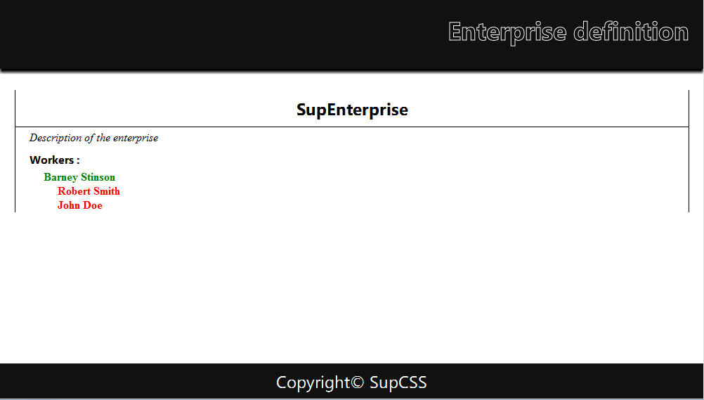
Xml Rendering
Namespaces
Now you can style XML as easily as HTML!

Slide 57
Questions ?

Slide 58
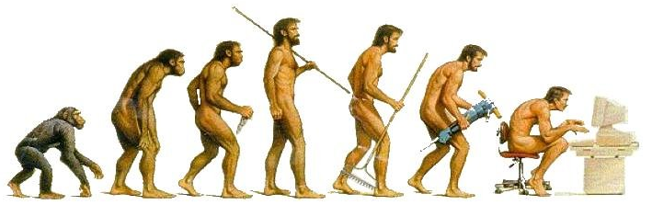
Transitions
CSS 3

Slide 59
Why transitions?
Transitions
CSS animating was a little criticized first
Style has been static since the beginning!
Think of transitions as dynamic styling
Allows to change CSS properties in a smooth way
Each time a style is applied to an element, the defined transition occurs

Slide 60
Syntax
Transitions
CSS transitions are composed of four properties:
property: For which property this transition applies
duration: How many seconds the transition takes
timing-function: Selects a built-in transition model
delay: Time to wait before perform transition
transition-property: color;
transition-duration: 1s;
transition-timing-function: ease;
transition-delay: 0s;

Slide 61
Notes
Transitions
transition-property:
Target multiple properties by separating each by a space
Target all properties by using the keyword « all »
transition-timing-function:
Eight methods available: linear, ease, ease-in, ease-out, ease-inout, step-start, step-end, custom*
Combine them by separating each by a space
Live demo showing six of these eight methods:
http://www.catuhe.com/msdn/transitions/easingfunctions.htm
Notes:
*Understanding custom timing functions:
http://www.w3.org/TR/css3-transitions/#transition-timing-function-property
http://matthewlein.com/ceaser/

Slide 62
How to…
Transitions
…write a shortcut to CSS transitions:
…define multiple transitions for each property:
…launch a transition:
By pseudoclasses (:hover, …), or by JavaScript
transition: color 1s ease 0s;
transition: color 1s ease 0s, opacity 0.5s linear 2s [,...];

Slide 63
JavaScript launching example
Transitions
<body>
<style>
p { color: blue; font-weight: bold;
cursor: pointer; }
.dark { color: black;
transition: color 10s ease 0s; }
</style>
<p onclick="this.className = 'dark'">
Join the dark side!
</p>
</body>

Slide 64
Pros and cons
Transitions
Advantages:
Lightweight and easy
Use hardware acceleration
Performs smooth transitions for UI enhancement
Drawback:
Executed one time per action!
So how to write animations ? (endless transitions)

Slide 65
Keyframes
Transitions
@keyframes are rules you can use to create animations:
@keyframes <animation-name> { … }
Inside it, describe the animation with keywords
from and to
percentages for each animation step

Slide 66
Keyframes
Transitions
Examples:
@keyframes my-animation {
0% { color: red; }
50% { color: purple; }
100% { color: blue; }
}
@keyframes other-animation {
from { font-size: 16px; }
to { font-size: 30px; }
}

Slide 67
Assign keyframes
Transitions
CSS « animation » property
Specifies which element use which animation
Most useful derivatives:
name: The name defined in keyframes
duration: How many seconds to do the process
iteration-count: Number of repetitions
You can use the keyword « infinite » if you want
timing-function: Same as transitions

Slide 68
Assign keyframes
Transitions
Example:
#mySuperElement {
animation-name: my-animation;
animation-duration: 1s;
animation-iteration-count: 3;
}
/* Or simpler... */
.otherElements { animation: other-animation 5s infinite; }

Slide 69
Browser Compatibility
Transitions
As new CSS attributes, those properties may need to be used with the vendor prefix
Example with webkit:
@-webkit-keyframes my-animation { /* ... */ }
#myWebkitElement {
-webkit-transition: all 1s ease-inout 5s;
-webkit-animation: my-animation 1s 3;
}
Notes:
http://www.w3.org/TR/CSS21/syndata.html#vendor-keywords
http://peter.sh/experiments/vendor-prefixed-css-property-overview/

Slide 70
Questions ?

Slide 71
Exercise (1/2)
Transitions
Get the following XML file:
http://www.w3schools.com/xml/simple.xml
Enrich it with some logical namespaces
Style it with CSS and render it as a classical HTML page

Slide 72
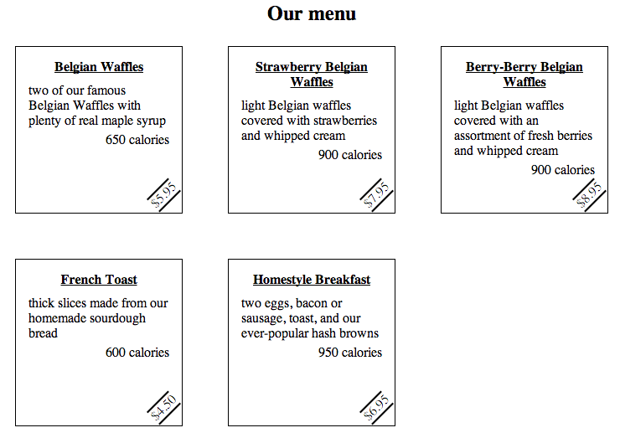
Exercise (2/2)
Transitions
Possible rendering:

Slide 73
Exercise (3/3)
Transitions
Now add some animations in your XML design!
Make your elements change with at least:
One tranformation
One transition
One keyframe

Slide 74

The end
CSS 3
Thanks for your attention

